Slide 1
INSERT LOGO HERE

Slide 2

Welcome!
Please feel free to take our short quiz by first picking a seed.
Mental Health Resources Near Me

Slide 3
Now, let’s answer some questions to watch our seed grow

Slide 4
Question
Agree
Disaree

Slide 6
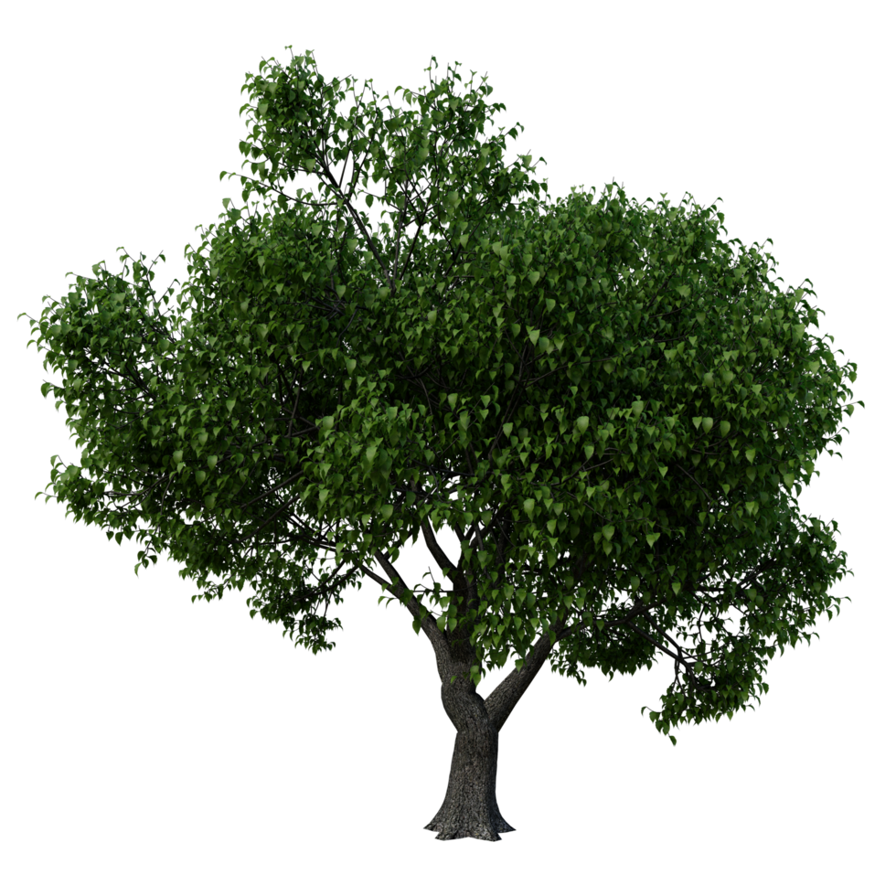
Yay! You planted your tree! Look at it grow!

Slide 7
Yay! You planted your tree! Look at it grow!
Now Let’s See what else you can do

Slide 8
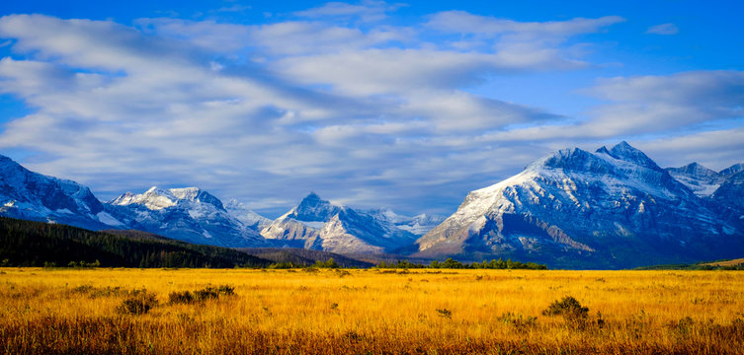
My Tree
Resources
My Journal
Activites
Survey
Settings
Numbers for Emergency Situations

Slide 9
Resources
Here is a list of resources that are available for you or someone else you know.
RESOURCE 1
RESOURCE 2
RESOURCE 3

Slide 10
Activites
Here are some activities you can do to practice mental health.
Activity 1
Activity 2
Activity 3

Slide 11
My Journal
Welcome to your journal! A Place where you can write down your thoughts
New Entry
Entry 3
Entry 2
Entry 1

Slide 12
Survey
We want to hear from you. Feel free to take this survey to tell us about your thoughts with the app
Survey Link

Slide 13
Settings
Volume
Sound Effects
Colors
Location and Data
Clear All Data

Slide 14
Emergency Service Numbers
Number for x crisis
Number for x crisis
Number for x crisis
.
.
.
.
.
.
.
.
.
.
.

Slide 15
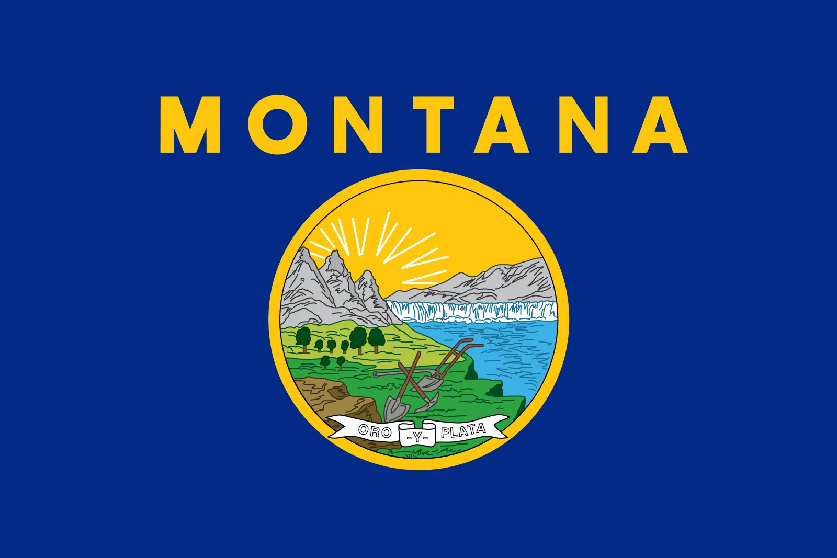

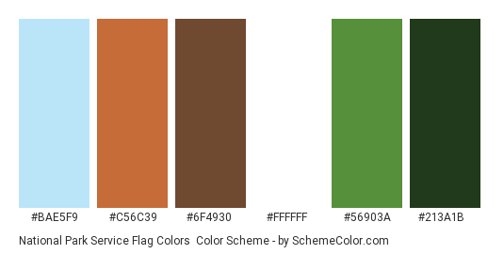
Potential Color Palettes.
Montana State Flag. Blues, yellows, greens.
Soft Pastels
Soft blues, greens, yellows.
National Park Colors.

Slide 16


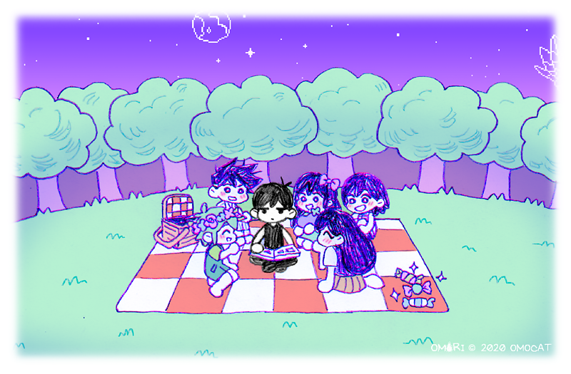
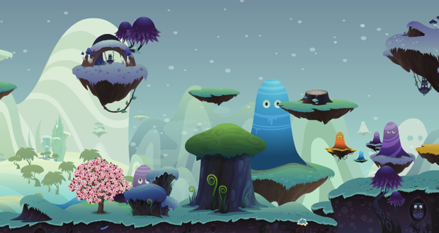
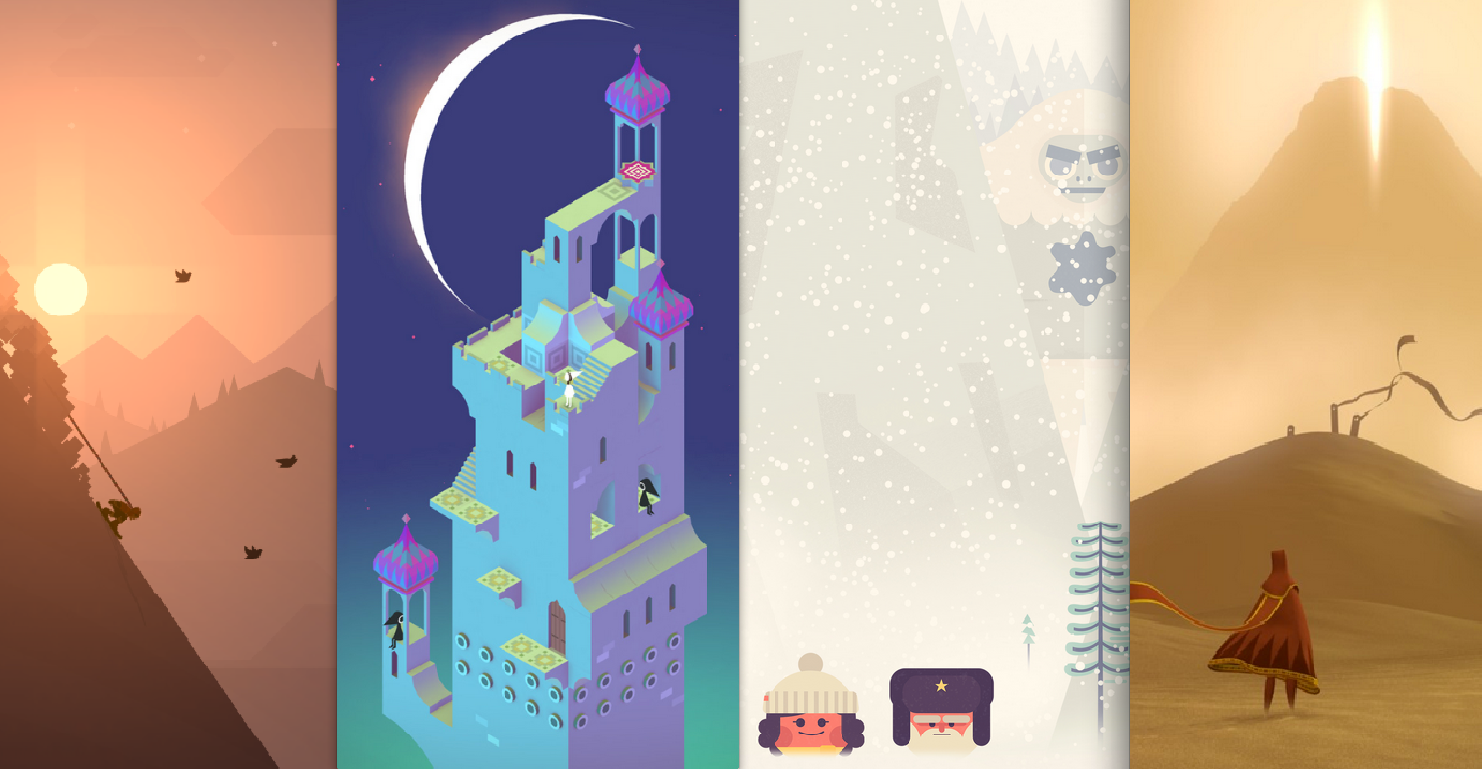
Art Styles
Stylized “Indie” art style.
Gives the game a sense of a pleasing visual style.
Might turn some people off if the art style doesn’t “wow” them.
Might be more time consuming to accomplish.
Corporate Memphis
Accessible, easy to understand and execute
Might get made fun of, considered too “basic.”
Less time consuming with the basic shapes.

